Slide 1
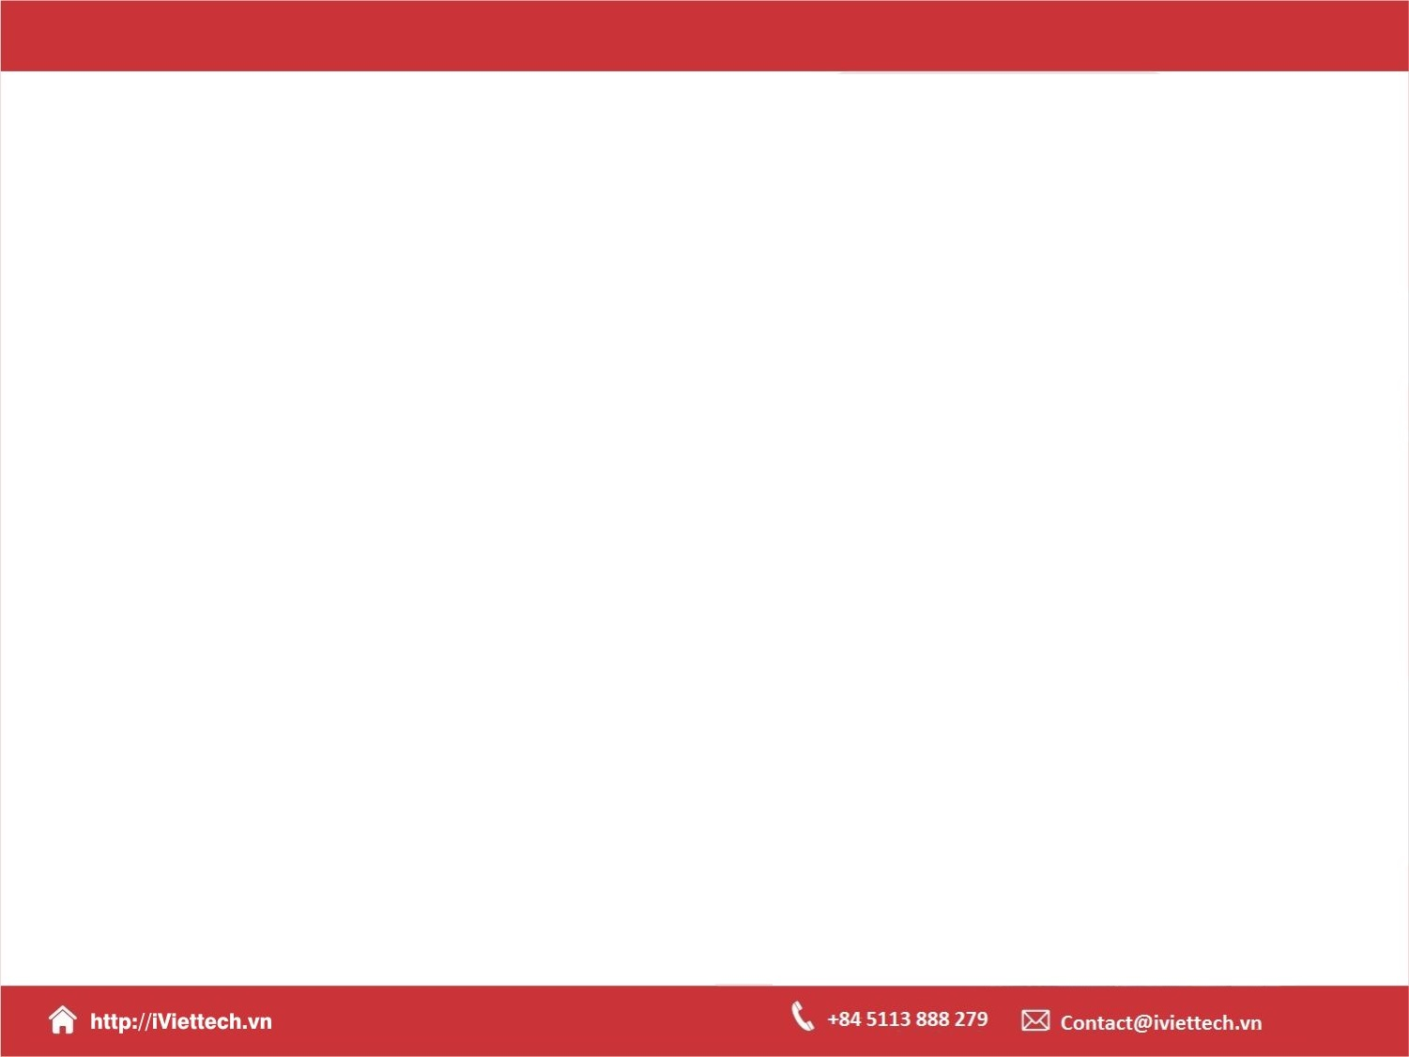
Chapter 4 – S5+S6
How to work with JavaScript objects, functions, and events
Notes:
Session: Ghi số thứ tự session trong môn học
Session Name: ghi tên của session sẽ dạy

Slide 2
Objectives
How to use objects to work with data
How to use functions
How to handle events
Two illustrative applications
Notes:
Mô tả nội dung mà học viên phải đạt được khi kết thúc môn học này

Slide 3
How to use objects to work with data
Notes:
Session: Ghi số thứ tự session trong môn học
Session Name: ghi tên của session sẽ dạy

Slide 4
How to use the window and document objects
The window object is the global object, and JavaScript lets you omit the object name and dot operator when referring to the window object.
The document object is the object that lets you work with the Document Object Model(DOM).

Slide 5
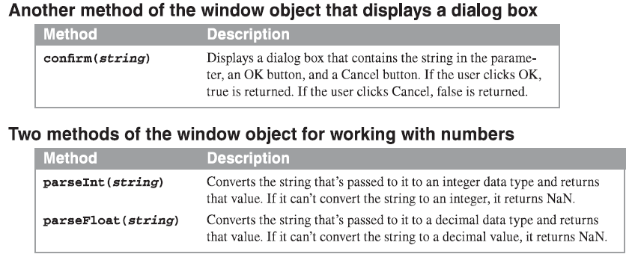
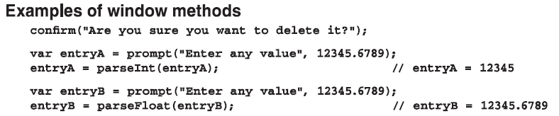
How to use the window and document objects (cont.)

Slide 6
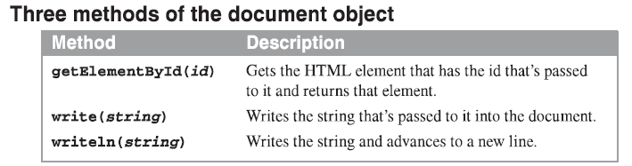
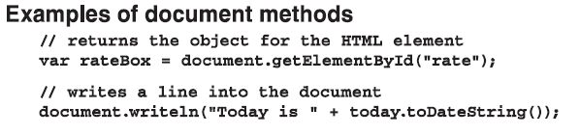
How to use the window and document objects (cont.)

Slide 7
How to use Textbox and Number object
The Textbox object is one of the DOM object.
When you assign a numeric value to a variable, a Number object is created. The you can use the Number methods with the variable.

Slide 8
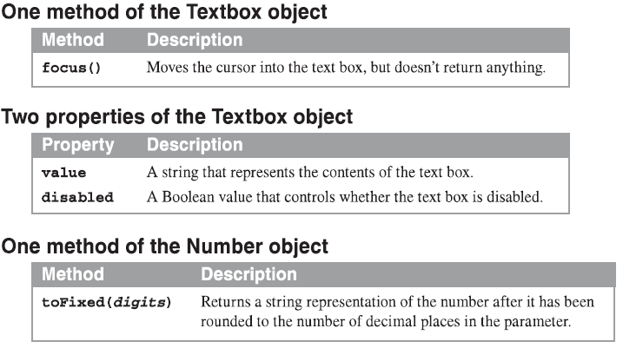
How to use Textbox and Number object (cont. )

Slide 9
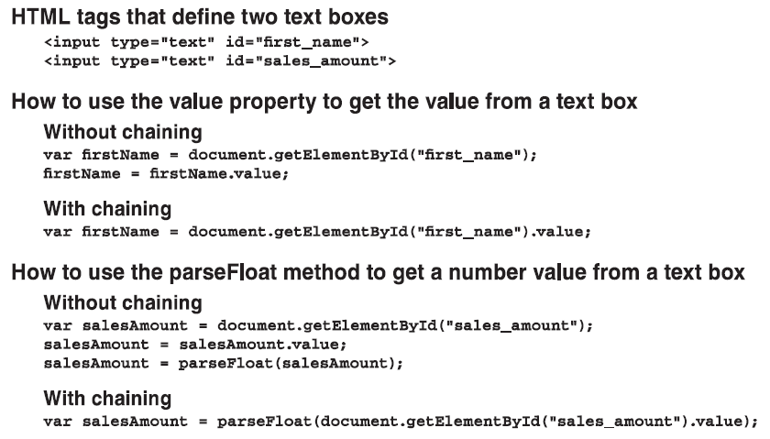
How to use Textbox and Number object (cont. )
Notes:
blur() c.toPrecision(2)

Slide 10
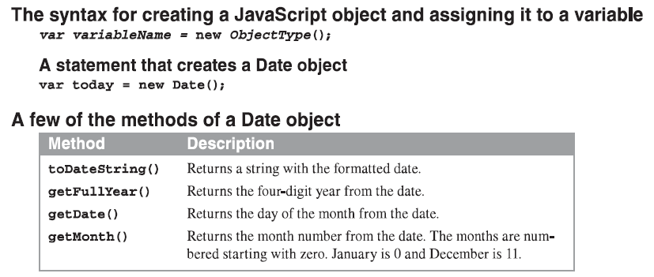
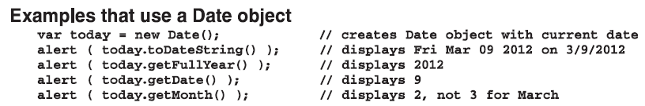
How to use Date and String objects

Slide 11
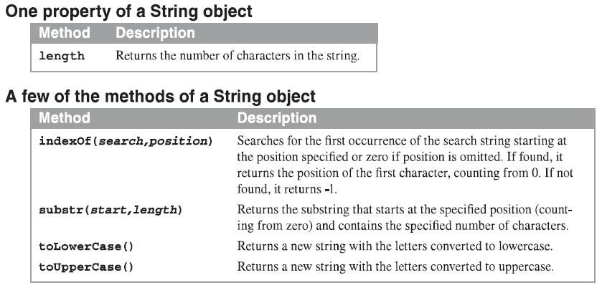
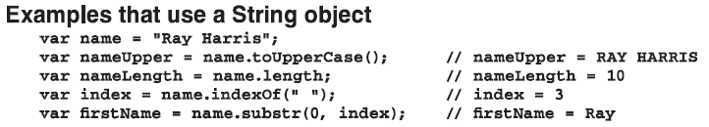
How to use Date and String objects (cont.)

Slide 12
Introduction to DOM
The DOM(Document Object Model) is a hierarchical collection of nodes in the web browser’s memory that represents the current web page.
The DOM of a web page is built as the page is loaded by web browser.
JavaScript can modify the web page in the browser by modifying the DOM.
To modify DOM you can use properties and methods of it.

Slide 13
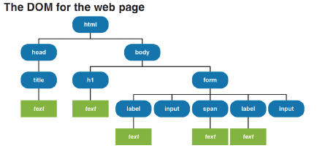
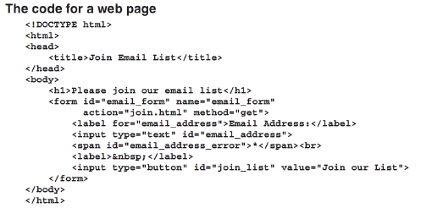
DOM example

Slide 14
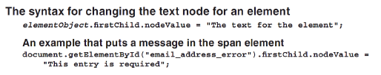
How to use DOM to change the text for an element

Slide 15
How to use functions
Notes:
Session: Ghi số thứ tự session trong môn học
Session Name: ghi tên của session sẽ dạy

Slide 16
How to create and call a function expression
A function is a block of statements that perform an action.
It can receive parameters and return a value by issuing a return statement.

Slide 17
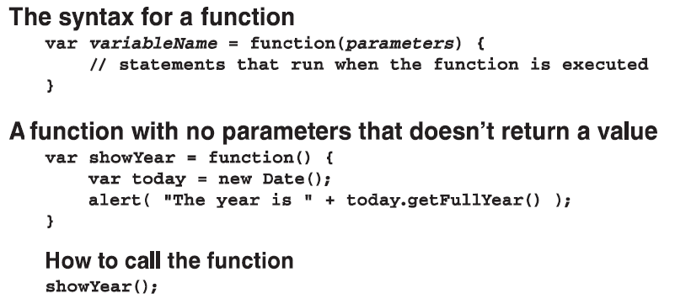
How to create and call a function expression (cont.)

Slide 18
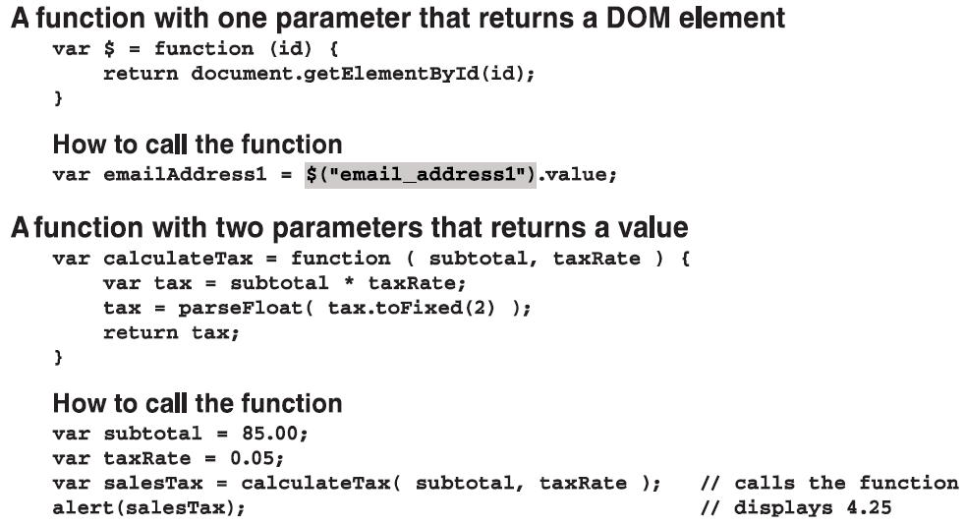
How to create and call a function expression (cont.)

Slide 19

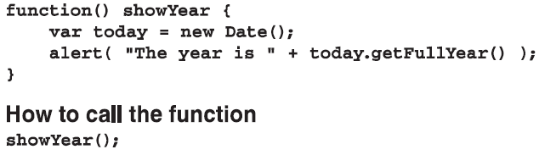
How to create and call a function declaration
A function declaration is one that is coded with a name and is’nt assigned to a variable.
The syntax for a function declaration
A function declare with no parameters that does’nt return a value

Slide 20
How to create and call a function declaration (cont.)
A function declare with one parameter that return a DOM element
function $(id){
return document.getElementById(id);
}
How to call the function
var emailAddress1 = $(“email_address1”).value;
A function declare with one parameter that return a DOM element
function calculateTax(subtotal, taxRate){
var tax = subtotal * taxRate;
tax = tax.toFixed(2);
return tax;
}
How to call the function
var subtotal = 85.00;
var taxRate = 0.05;
var salesTax = calculateTax(subtotal, taxRate);
alert(salesTax);

Slide 21
How to use local and global variable
Variables that are created inside a function are local variables, and local variables can only be refered to by the code within the function.
Variables created outside of function are global variables, and the code in all functions has access to them.
The scope of a variable or function determines what code has access to it.

Slide 22
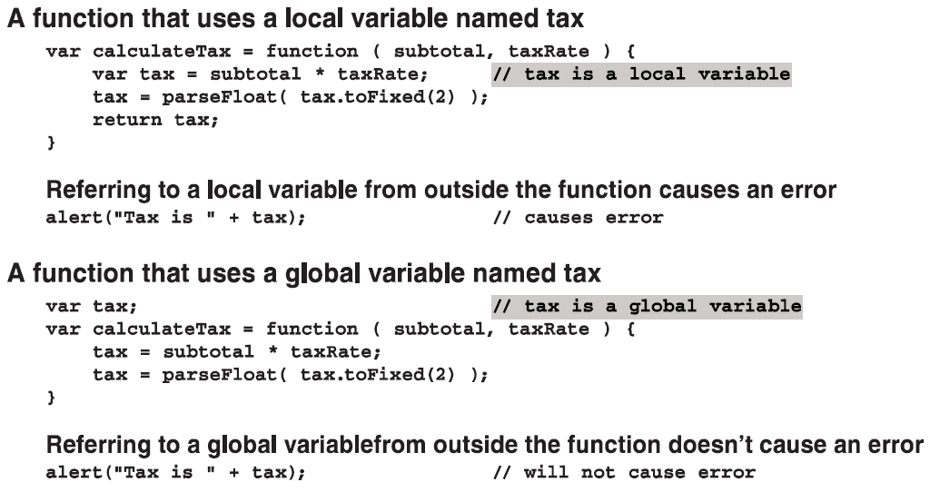
How to use local and global variable (cont.)

Slide 23
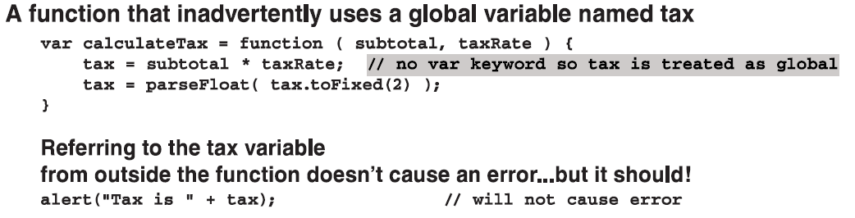
How to use local and global variable (cont.)

Slide 24
How to use strict mode
When you use strict mode, if you forget to code the var keyword in the variable declaration or if you misspell a variable name that has been declared, the JavaScript engine will throw an error.
The strict mode directive
“use strict”; //goes at the top of a file or function
A function that inadvertently uses a global variable named tax
var calculateTax = function(subtotal, taxRate){
tax = subtotal * taxRate;
tax = tax.toFixed(2);
};
Reference te tax variable outside the function
alert(“Tax is ” + tax); //will not cause error

Slide 25
How to use strict mode (cont.)
The same function in strict mode
“use strict”;
var calculateTax = function(subtotal, taxRate){
tax = subtotal * taxRate;
tax = tax.toFixed(2);
};
Reference te tax variable outside the function
alert(“Tax is ” + tax); //cause error

Slide 26
When to use local and global variable
Best coding practices
Use local variables whenever possible.
Use var keyword to declare all variables
Use strict mode
Declare the variables that are used in a function at the start of the function.

Slide 27
How to handle events
Notes:
Session: Ghi số thứ tự session trong môn học
Session Name: ghi tên của session sẽ dạy

Slide 28
Event and Event handler
Event is a action from user or another system like click, mouse over...
Event handler is a functions is executed when an event occurs.

Slide 29
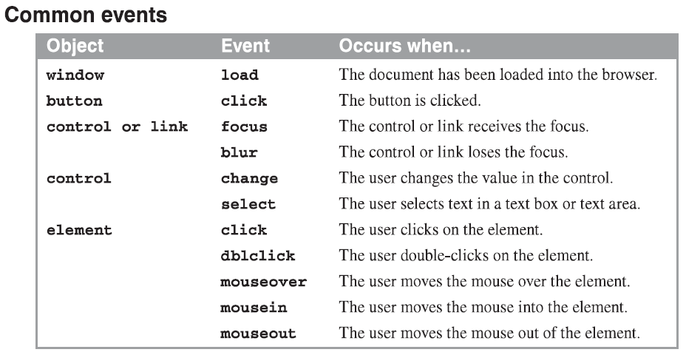
Event and Event handler (cont.)

Slide 30
How to attach and event handler to an event
The syntax for attaching an event handler
objectVariable.oneventName = eventHandlerName;
An event handler named joinList
var joinList = function(){
alert(“The statements for the function go here”)
};
How to attach the event handler to the click event of a button
$(“submit_button”).onclick = joinList;
How to attach the event handler to the double-click event of a text box
$(“text_box_1”).ondblclick = joinList;
How to create and attach an event handler in one step
Window.onload = function(){
alert(“This is the window onload event handler function.”);
}

Slide 31
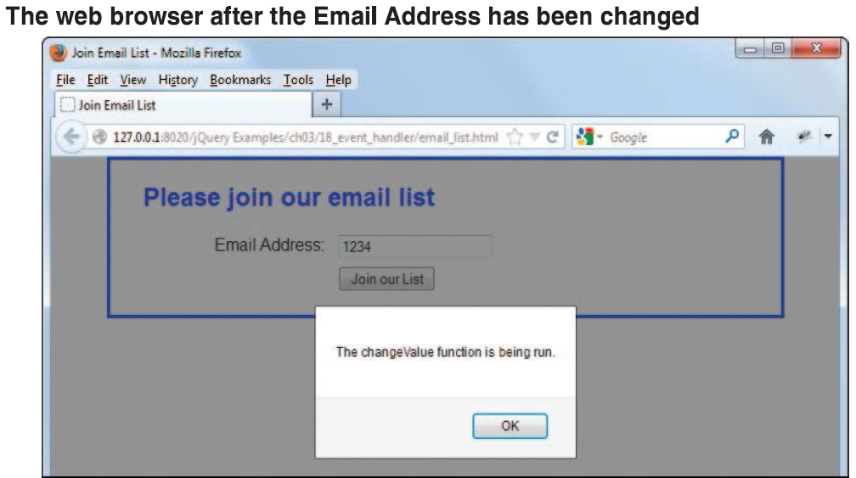
How to use an onload event handler to attach other event handlers

Slide 32
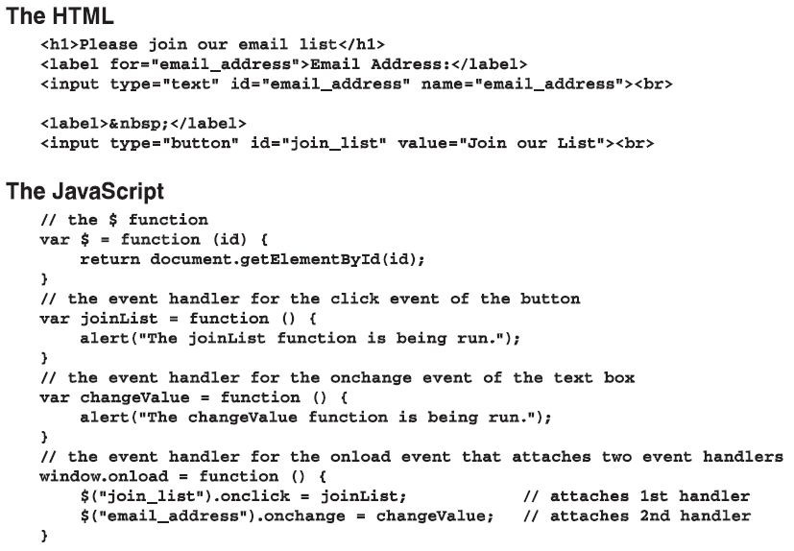
How to use an onload event handler to attach other event handlers (cont.)

Slide 33
Two illustrative applications
Notes:
Session: Ghi số thứ tự session trong môn học
Session Name: ghi tên của session sẽ dạy

Slide 34
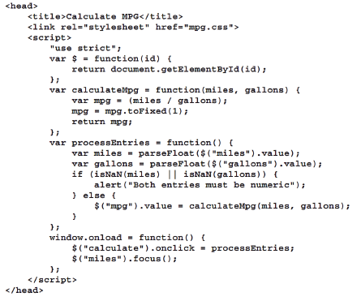
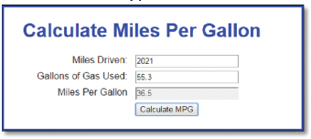
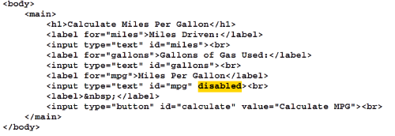
The Mile Per Gallon application
Interface
HTML code
JavaScript code

Slide 35
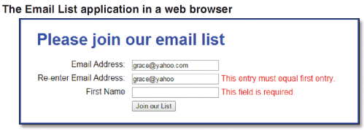
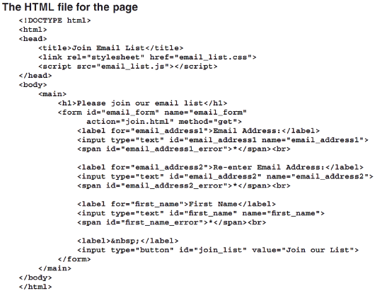
The Email List application

Slide 36
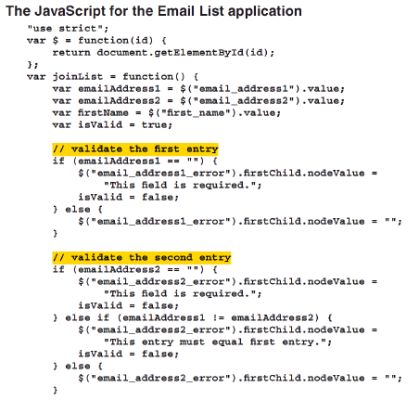
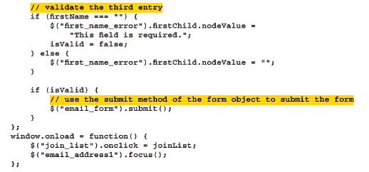
JavaScript code
for Email List application

Slide 37
Summary
The window object is the global object, and JavaScript lets you omit the object name and dot operator when referring to the window object.
The document object is the object that lets you work with the Document Object Model(DOM).
A function is a block of statements that perform an action. It can receive parameters and return a value by issuing a return statement.
Event is a action from user or another system like click, mouse over...
Event handler is a functions is executed when an event occurs.
Notes:
Tóm tắt lại nội dung đã học

